Slide 1
MVC Demo
By: Madhusoodan M Pataki

Slide 2
Madhusoodan M Pataki
Student @ SDM College of Engg. & Tech.
5th semester, ‘A’ division
Dharwad.
Email : akshayapataki123@gmail.com

Slide 3
Content
What is MVC
What this project is [Not]…
Outline of the project
Protocol Overview
Demo
Code Review

Slide 4
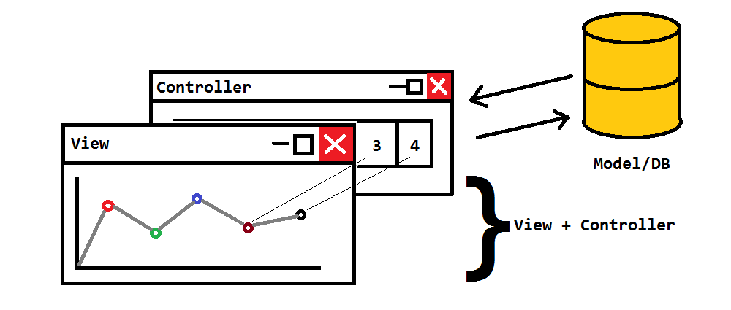
What is MVC ?

Slide 5
What this project is…
This is just a demo of MVC.
Helps understanding how MVC works.
Built just for max 10 clients and 16 data entries.
1 Model : 10 Controllers/Views
1 Model : 16 Data entries

Slide 6
What this project is not…
This is not a software product to be sold.
May fail sometimes due to some socket failures.
May not accept connection sometimes.
Abrupt termination of Model.
No security measures are taken
Any one can play with data.
Can cause buffer-overflow.
Insert some absurd values.
One person can connect many times (DOS attack).
Can also make model to terminate.

Slide 7
Outline of Project
Selection of the platform, Language, Libraries.
Windows Platform.
C, C++ Language.
Win32 & mGLAPI.

Slide 8
Outline of Project
Model
Holds the data centrally.
Holds communication links of all clients.
Signals them if any changes occur.

Slide 9
Outline of Project
View
Holds a local copy of the data.
Allows the actor to view some kind of representation of data.
Pie-Chart/Bar-Chart/Dot-Chart.
Updates itself whenever local data changes.
Doesn’t change data.

Slide 10
Outline of Project
Controller
Allows actor to modify local data *.
Notifies the Model about changes done.
Upon confirmation of change notifies View about change.
* No one can directly change local-data. Change must be notified from Model

Slide 11
Outline of Project
Communication between Components [Model & Controller]
Using sockets.
A simple protocol.

Slide 12
1. Successful connection.

Slide 13
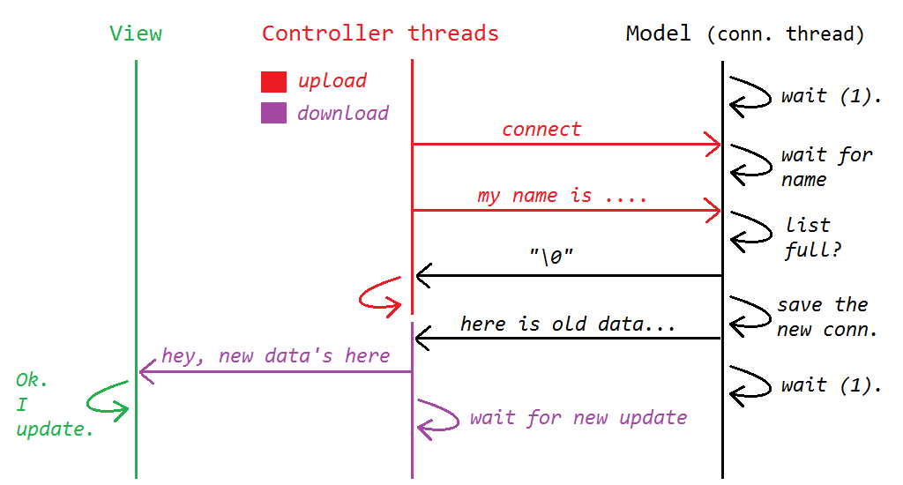

Slide 14
2. Unsuccessful connection.

Slide 15
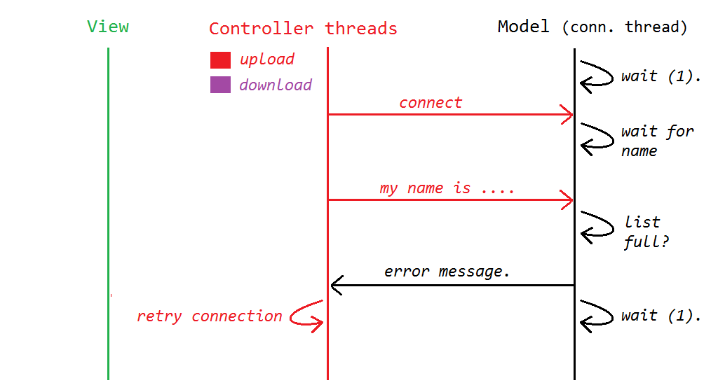

Slide 16
3. Successful Addition/Modification of data.

Slide 17
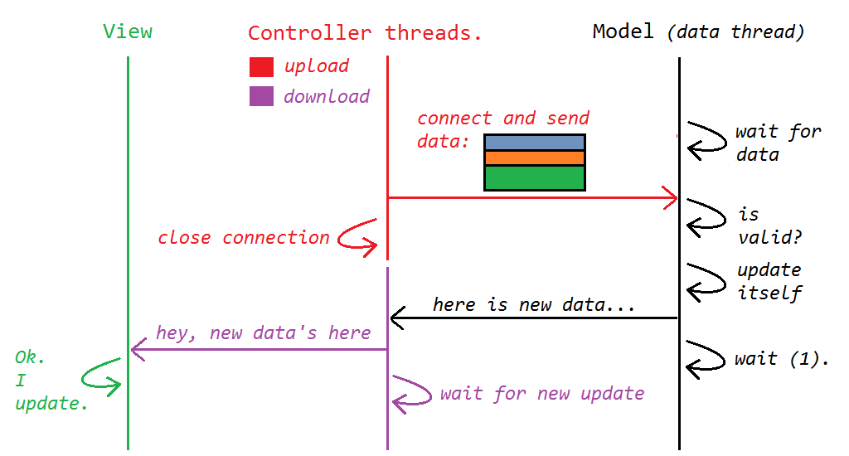

Slide 18
3. Unsuccessful Addition/Modification of data.

Slide 19
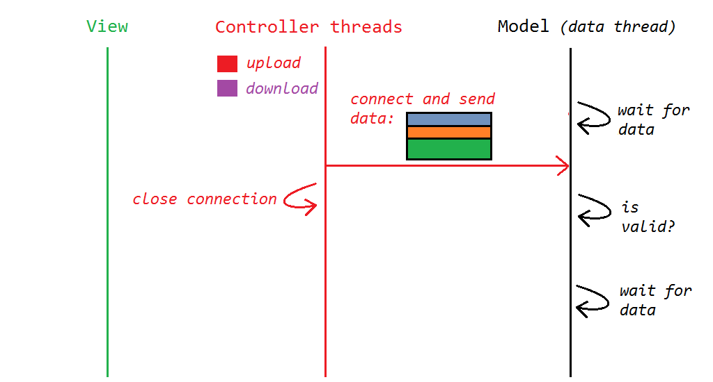

Slide 20
Protocol Header + Data
Name_of_User
A/M/U
Number_of_operations
Key1 Value1
Key2 Value2
. . .
KeyN ValueN
A : Add.
M : Many.
U : Update.
KeyN: label/Index of ValueN.
ValueN : value of data entry.

Slide 21
Demo Time.

Slide 22
Code Review
#include <stdio.h>
int main()
{
printf(“open code”);
return 0;
}

Slide 23
How to make things go wrong here.
Connect to Model and don’t tell your name. A server thread will wait for an infinite time (until it exits).
Connect to Model and tell a long name such that name buffer overflows.
Send data frequently to make server busy all the time.
Even if service is not available send modifications. Since there is no server side authentication this can be done.

Slide 24
Thank You.

